Slide 1
Welcome to the Data Analysis Level 4 Module 5 training session

Slide 2
Quick introduction from the tutor
Page 2
Notes:
2 mins
Most important – ask participants to close all the background apps that may be taking up bandwidth – apps like Outlook, Spotify, SharePoint, Dropbox, etc. all take up a lot of internet!
1 min
It’s easy to drift off and think about work or other things going around you.
There will be plenty of breaks in the day to check up on work/life/family.
But while you are here with us, don’t be distracted.
Be present.
1 min
You’ll appreciate that we have limited time together to learn some of the finer techniques of data analysis.
Please don’t waste time by being late or disappearing down a black hole.
Please be on time.

Slide 3

Check-in and onboarding
The check-in and onboarding session is from 09:00 to 09:45
The onboarding session will ensure you can log in to the Remote Desktop Environment. Student Success Advisors will be available to assist with any technical issues you may experience
The virtual class will formally begin at 10:00
Page 3

Slide 4

Onboarding process
Prior to starting the class, each learner needs to go through all five of the stages below to ensure they have the tools necessary for the training course. The learner will need to access the Remote Desktop Environment, navigate through its functionalities, access content, run software, understand rules and best practices, and carry out other induction-related exercises.
Adobe Connect
- Instructors intro
Connect to RDE
- Self-help to RDE
RDE exploration
Introduction
- Intro
- Schedule
- Breaks
- General rules
Lecture begins
- Attendance
- Theory
- Discussion
- Labs
- Communication 101
- Attendance
- Optimise for connectivity
- Map
- Get support
- Software checklist
- Dual/split screen optimisation
- Folder: ‘Course Files’
- Access to content
- Navigating RDE
1
2
3
4
5
Page 4

Slide 5
Stage 1 Adobe Connect
Page 5

Slide 6
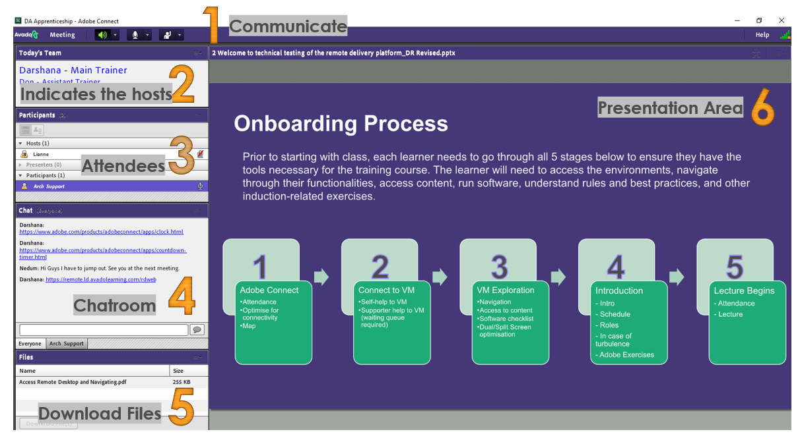
Lobby
When you enter Adobe Connect, you’ll see the lobby, which consists of various sections.

Slide 7
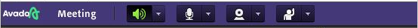
Communication
.
A
B
C
D
A. Sound – check best sound level
B. Mic – check best mic level (40–50%)
C. Video Cam – check for best video quality (usually turned off for all by tutor to minimise bandwidth/WIFI issues)
D. Respond – options are available to respond to questions or to get tutor attention
Notes:
2 mins
​
Tutor to run through how to:​
Mute/unmute – enable participants to unmute themselves and ask them to check if they can unmute themselves. Then ask them to stay on mute unless speaking​
Put video on/off – Show participants how to keep video on/off and ask them to stay off at all times, unless requested to go on​
Use chat feature – Show participants how to use the chat feature to message everyone and to message privately (if enabled). Ask participants to keep the chat box open at all times, so that they can answer facilitator Qs during discussions and ask their own questions to the facilitator​
Ask and respond to Qs – Ask participants to be active and participate – by answering Qs, participating in discussions and asking Qs for a more enriched learning experience. They can ask Qs as they progress, but also ask learners to make notes of Qs they may want to ask later if the Q is not critical at this point​
Use whiteboard features – Quickly show how they can use the Annotate feature when using whiteboards in class discussions and in breakout rooms​
Participate in Breakout rooms – Explain what will happen with the breakout rooms – how to join, that video and audio features will work similarly, how to use the share screen option if required, and how to ask for help from the host​
Then, ask if anyone has any quick Qs on how to use Adobe Connect and other features (tech facilitator to answer these questions).

Slide 8
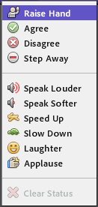
Example
A
B
C
D
Respond options exercise:
Is this your FIRST LIVE ONLINE course?
Page 8

Slide 9
Stage 2 Remote Desktop Environment
Page 9

Slide 10
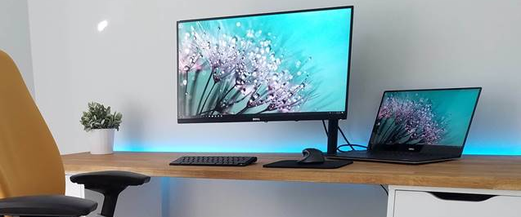

Dual screen – strongly recommended (option 1)
Remote Desktop Environment
Adobe Connect
Page 10

Slide 11
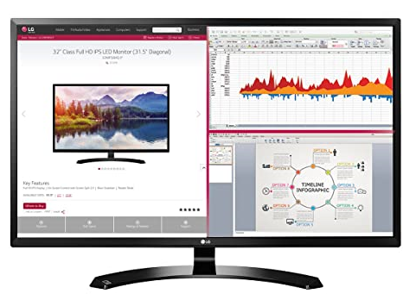
Split screen (option 2)
Remote Desktop Environment
Adobe
Connect
22–24 inch monitor
Page 11

Slide 12
How to access the remote desktop: Step 1
To get started, please go to the login URL for remote desktop: https://remote.ld.avadolearning.com/rdweb/webclient/index.html
Enter the username and password that has been allocated to you. Please note the following:
Passwords are case sensitive
Make sure no spaces are accidentally added when using cut & paste

Slide 13
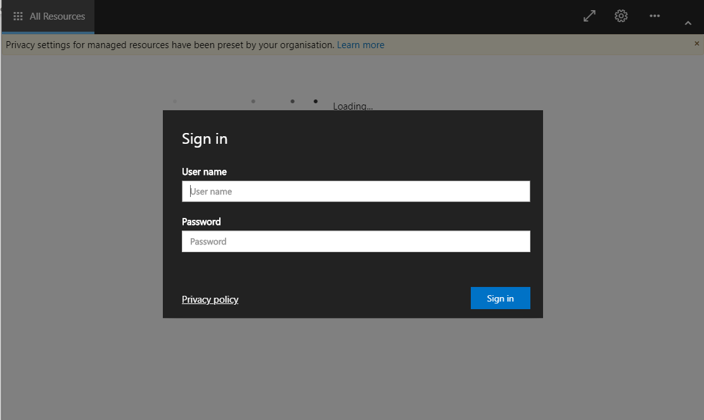
How to access the remote desktop: Step 2
username
password

Slide 14
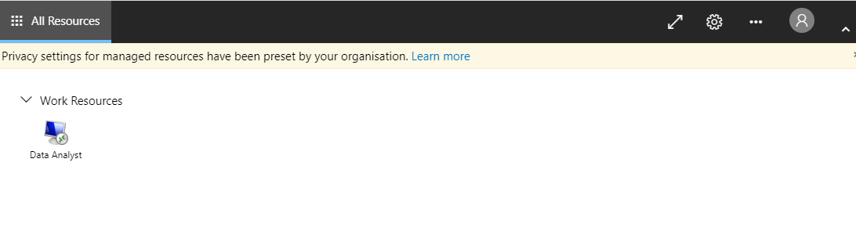
How to access the remote desktop: Step 3
After entering your username and password correctly, you’ll reach the following screen. Please click on the ‘Data Analyst’ icon.
Click Here

Slide 15
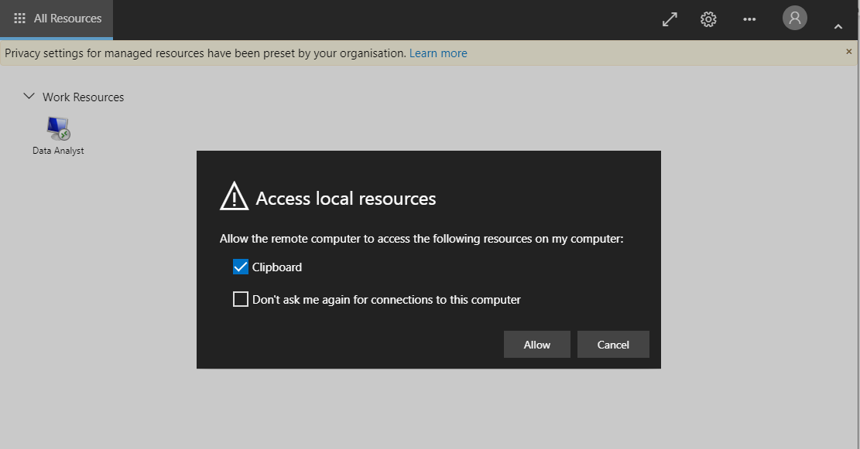
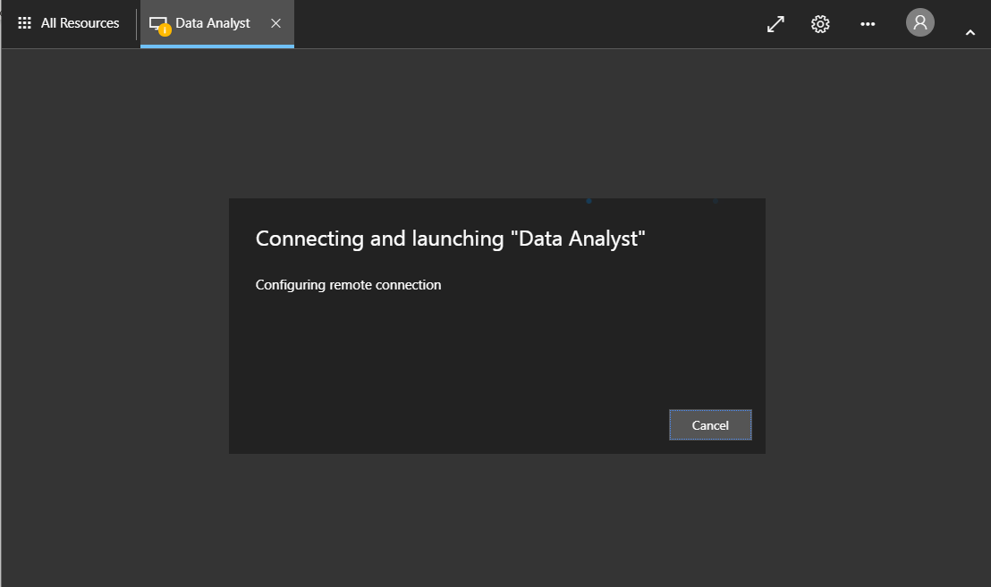
How to access the remote desktop: Step 4
1
A notification box will appear as shown in . Please click ‘Allow’.
The Remote Desktop Environment is now connecting, and you may see screen for a few moments as it loads.
2
1
2

Slide 16
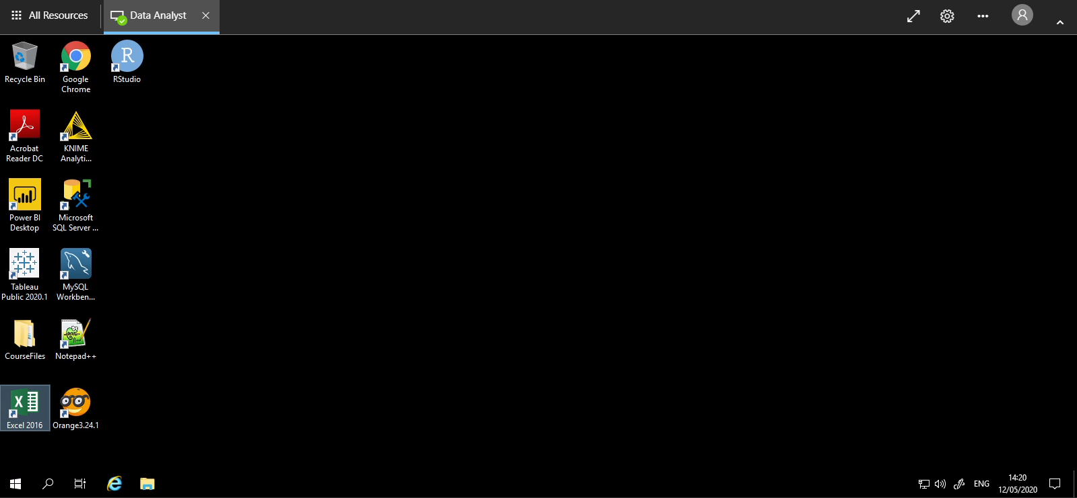
Congratulations, you now have access to the remote desktop!

Slide 17
Stage 3 RDE exploration
Page 17

Slide 18
Explore the course files

Slide 19
Stage 4 Introduction
Page 19

Slide 20
Housekeeping
Course hours are 09:00 to 17:00
Please be on time
We'll break for lunch at around 12:30
Attendance will be taken in class at 09:00 and after lunch at 13:30
Keep your mic muted at all times unless you're asking a question
Close all other background apps that may be taking up bandwidth
Health and safety
Page 20

Slide 21

Briefly introduce yourself
Name
Company
Work location
Your role and how analytics relates to it
Analytics expertise
Page 21
Notes:
[Source image at a later date]

Slide 22

Course overview
The main aims of this course are:
To equip you with the right tools and information, so that you're able to offer professional, high-level data analysis and support
To explore a range of concepts, approaches and techniques that are applicable to data analysis
Page 22
Notes:
[Source image at a later date]

Slide 23



Daily agenda
Module 5: Day 1
Introduction to Adobe Connect, Virtual Classroom Environment and Avado Campus
Python for data science
Arithmetic and logical operators
Variables and built-in Functions
Data types: lists, tuples, sets, dict, string
Python if/else conditions
Python loops: for loop and while loop
Python open function and with open function
Page 23

Slide 24
Daily agenda
Module 5: Day 2
Advanced Python for data science
Exploring NumPy and Pandas libraries
Exploring data mining techniques
Module 5: Day 3 – Fusion Day
Page 24

Slide 25
Data Analyst Level 4 – programme overview
Module 1
Data analysis, architecture and data cleansing
Module 2
Data analysis and visualisation techniques
Module 3
Database design and reporting
Module 4
Data analysis and forecasting with R
Module 5
Data analysis and forecasting with Python
Key
Online learning
Virtual lab
Fusion day
10 hrs
14 hrs
7.5 hrs
10 hrs
14 hrs
7.5 hrs
10 hrs
14 hrs
7.5 hrs
10 hrs
14 hrs
7.5 hrs
10 hrs
14 hrs
7.5 hrs
Page 25

Slide 26

Two optional examinations
BCS Level 4 Certificate in Data Analysis Tools (KM1 Assessment)
BCS Level 4 Diploma in Data Analysis Concepts (KM2 Assessment)
Page 26

Slide 27

Overview of BCS L4 Certificate in Data Analysis Tools (KM1 Assessment)
Assessment for KM1 will be done by examination
Exam format:
One hour duration
Multiple-choice exam
40 questions in total
The pass mark is 26/40 (65%)
Closed-book examination (no materials allowed)
Online examination using a remote proctor
Page 27

Slide 28

Overview of BCS L4 Diploma in Data Analysis Concepts (KM2 Assessment)
Assessment for KM2 will be done by examination
Exam format:
One hour duration
Multiple-choice questions
40 questions in total
The pass mark is 26/40 (65%)
Closed-book examination (no materials allowed)
Online examination using a remote proctor
Page 28

Slide 29
Questions?

Slide 30
Stage 5 Lecture begins
Page 30

Slide 31
Thank you
careers@archapprentices.co.uk
https://www.avadolearning.com/arch-apprenticeships/

